Slide 1

f
BUDGET SUITES
MAKE YOUR SELF LUXURY

Slide 2
About US
Submitted By :-
 Virag Bavadiya B.
 Darshan Mangukiya V.
 Yash Bhimani P.
Submitted To :-
 Vidhyadeep Institute Of Computer & Information Technology
Internal Guide :- • External Guide :-
Ms. Heena Patel

Slide 3
Project Profile
Project Title :- Hotel Booking System
Platform :- Microsoft Windows 11
Front End :- Visual Studio 1.86.2
Back End :- NestJs & MongoDB
Web Server :- Local Host
Submitted to :- Veer Narmad South Gujarat University, Surat.

Slide 4
Environment specific
Hardware Requirement :-
Processor :- 12th Gen Intel(R) Core(TM) i5-1240H 2.00 GHZ
RAM :- 4 GB
Hard Disk :- Minimum 20GB Hard Disk With 4GB Free Space
Software Requirement :-
Operating System :- Windows - 8
Database :- MongoDB
Browser :- Google Chrome, Mozilla Firefox

Slide 5
Existing System
Time consuming.
Existing system in one type of web application.
Can’t get public’s response.
Customer some of rarely facility not available.
Data management working properly.
There is facility for live communication.
Can’t say to customers by sending SMS.

Slide 6
Advantages
Notification and message sending by admin for users.
To have ability to share application link to each other.
Customer can that beauty care home made tips and share to other.
Registered or un registered user both can watch services.

Slide 7
Drawback
Password can be easily hacked.
Existence of network is necessary.
Without the proper knowledge user can not use this application.

Slide 8
Overview
Budget suites provides hotel booking services.
User can advanced booking the appointment.
It’s made for time consuming.
Our aim is “Make your self luxury.”

Slide 9
Objective
Optimize operational efficiency
Enhanced Guests satisfaction
Maximum revenue from effective management
Ensuring seamless reservation
Accurate inventory management
Exceptional Customer’s services

Slide 10
Scope
This targets individual who are interested in booking hotel or just want to enquire about the hotel and rooms.
It also enables the organisation/admin to make changes to the hotels such as updating hotel information, adding new hotels or categories of rooms or delete an outdated hotels.
It also contains the details of rooms.
In short, the administrator in charge will be able to do the following :-
Update Hotel
Delete Hotel
Add Hotel
Keep data records
Track the number of check-in and check-outs

Slide 11
Context diagram (0 level dfd)
Hotel
Available rooms
Booked reservations
Add hotel, add user, update hotel
Login/Logout, reservation, user detail
Hotel Reservation
Admin
Users
Reports, customer care management, track activities, reservation status
Hotel search, reservation availability

Slide 12
E-R Diagram
UserId
UserType
Email
Password
Password
PhoneNo
isActive
UserName
Login
User Profile
Image
User
Country image
RoomTypes
CountryName
Images
HotelAddress
CountryCode
Country
HotelId
CountryId
CountryId
Search
Hotel
LocationId
Location
TotalRooms
LocationId
HotelCode
Location image
HotelName
LocationName
LocationCode
Book Hotel
RoomType
RoomId
RoomTypeId
Room
RoomTypeName
Image
RoomName
Price
OfferId
OfferType
Room_Type_id
OfferCode
Booking Details
Offers
IsOneTIme
BookingId
ExpiredOn
RoomPrice
OfferAmount
RoomImage
TotalAmount
Booking
Payment
Discount
BookingId
TransactionId

Slide 13
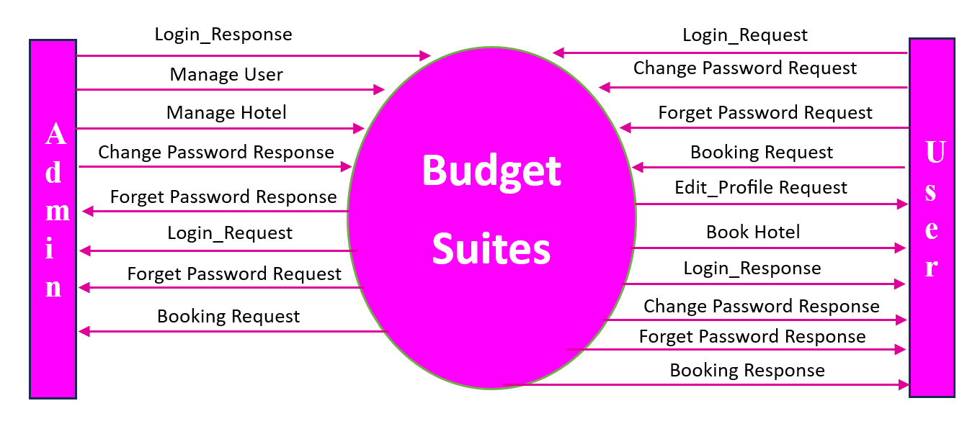
Context Level Diagram

Slide 14
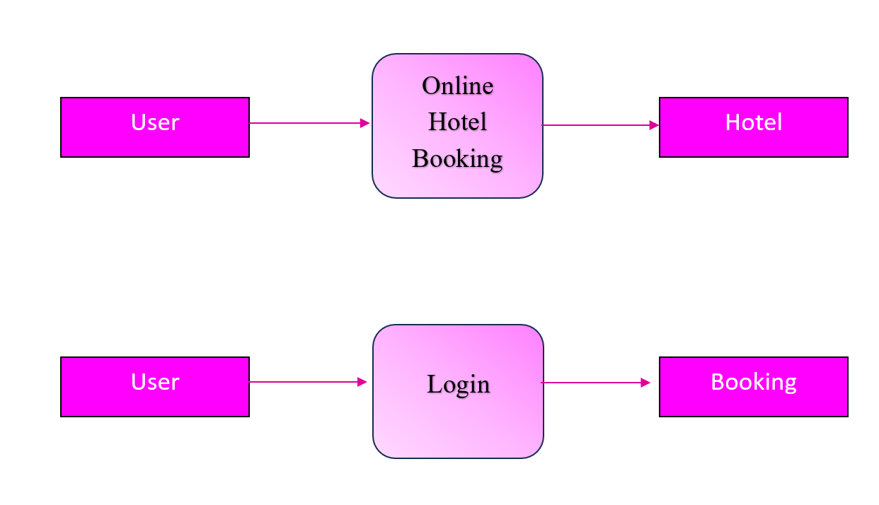
Context Level Diagram

Slide 15
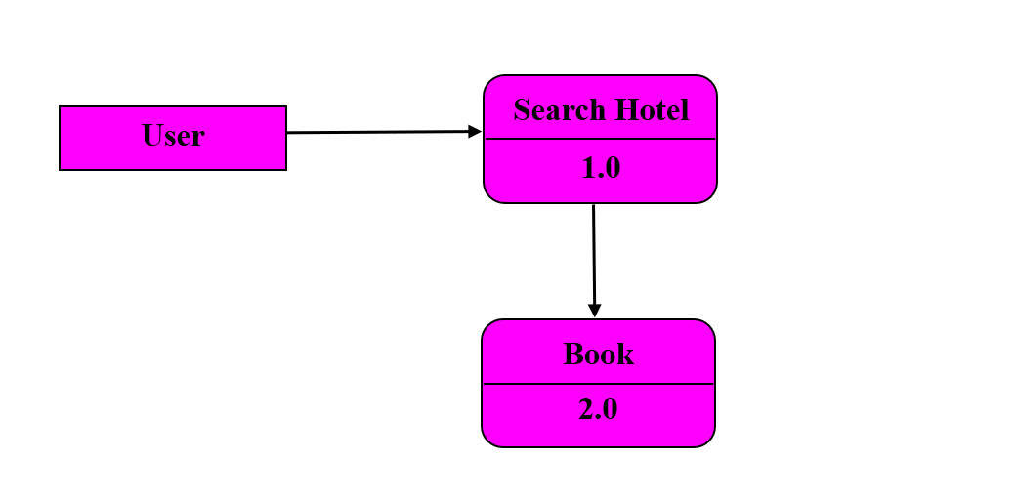
First Level Data Flow Diagram

Slide 16
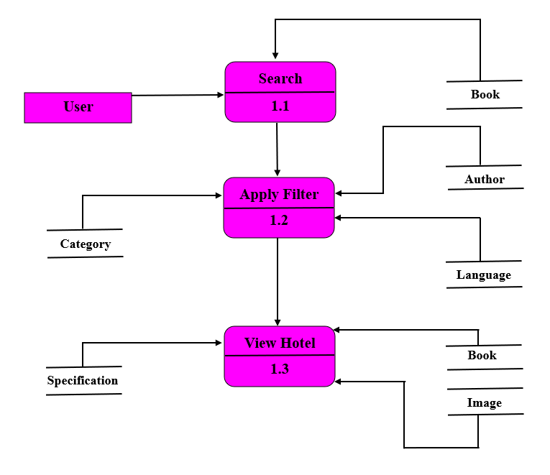

Slide 17
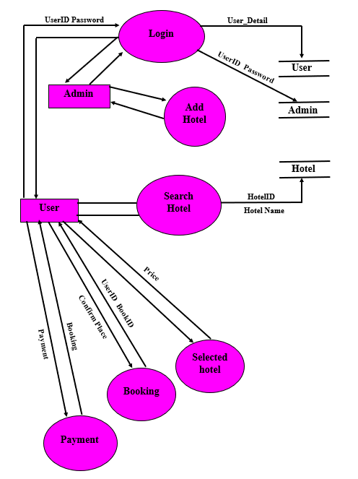

Slide 18
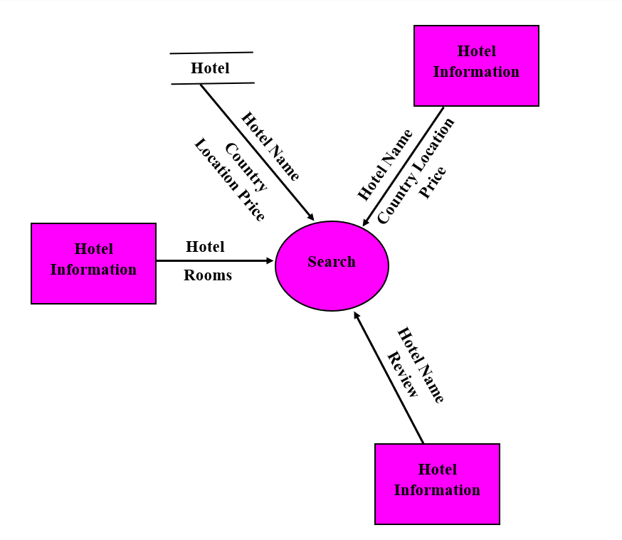
Second Level DFD

Slide 19
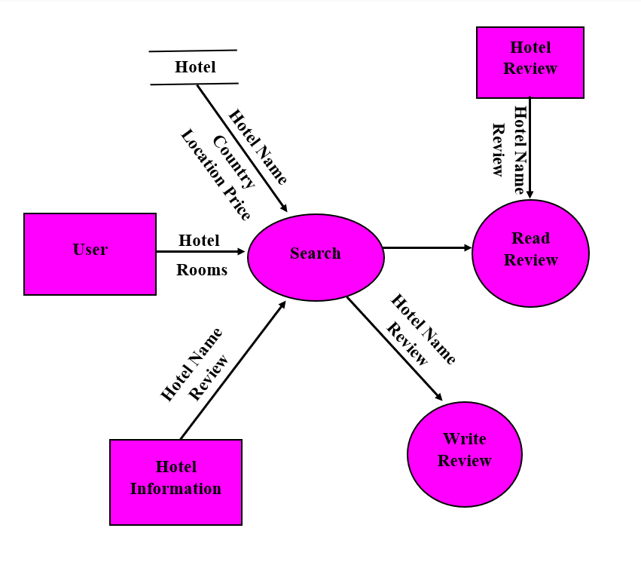

Slide 20
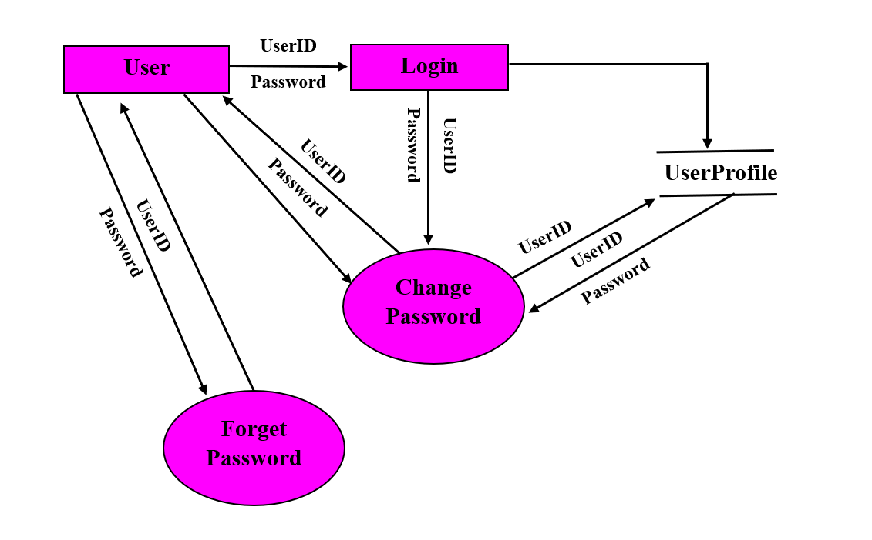
Change Password Second Level DFD

Slide 21
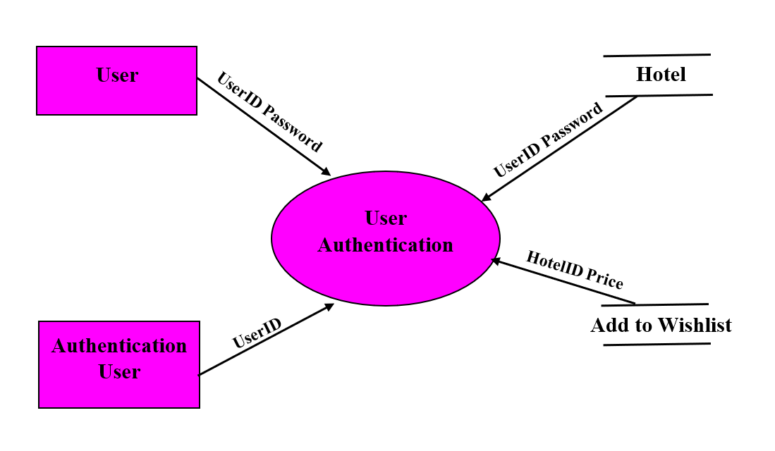
Customer Authentication Second Level DFD

Slide 22
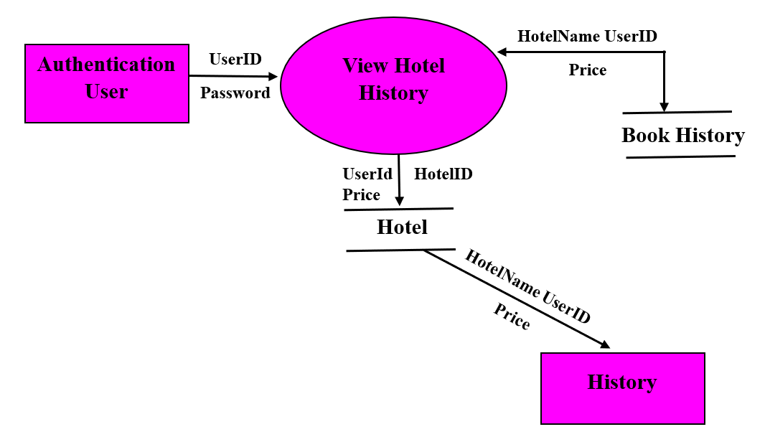

Slide 23
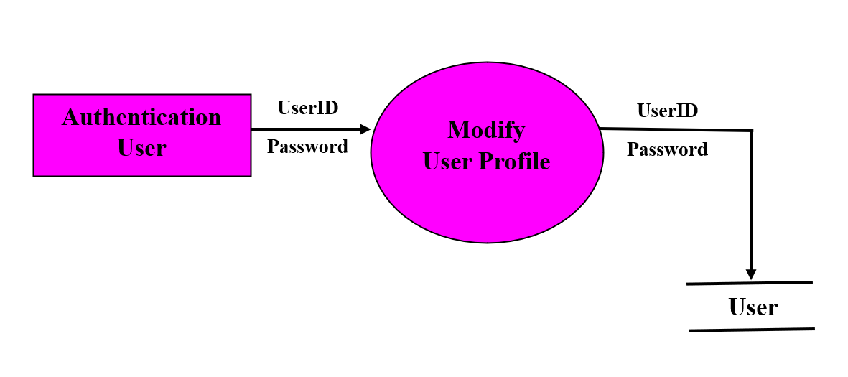
Customer Authentication User Profile DFD

Slide 24
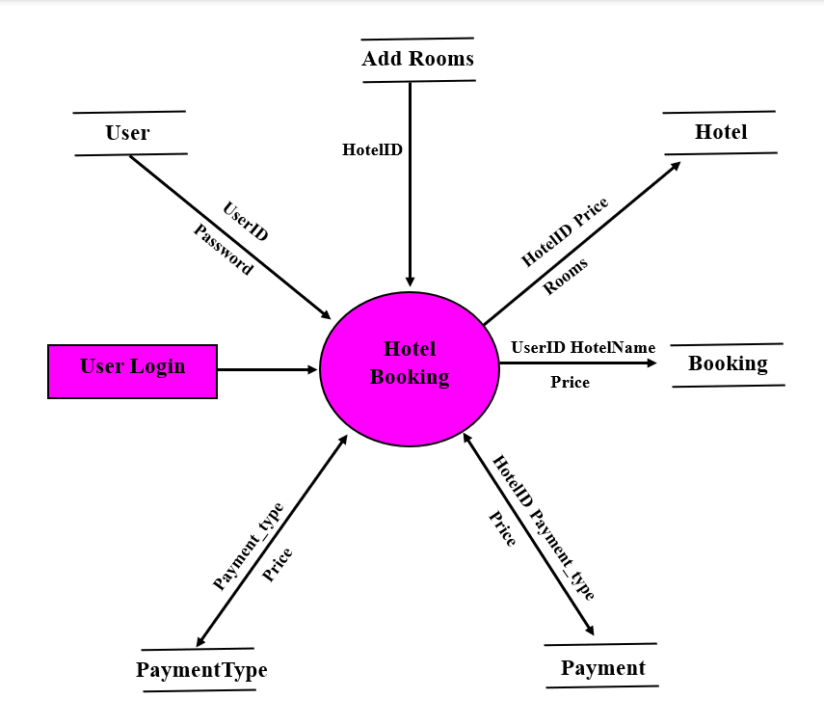
User Booking Second Level DFD

Slide 25
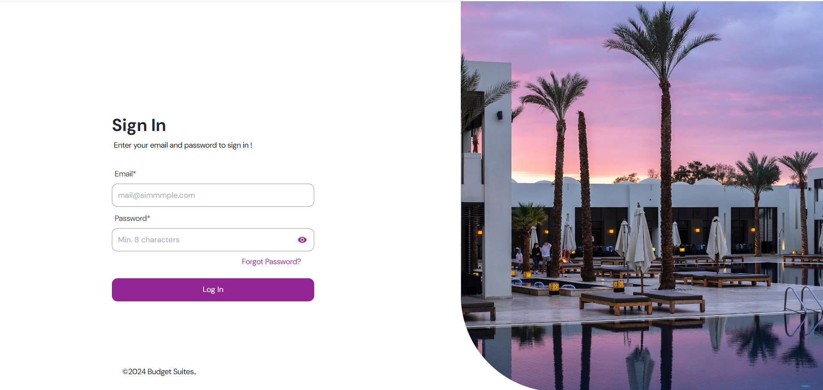
Sign-in

Slide 26
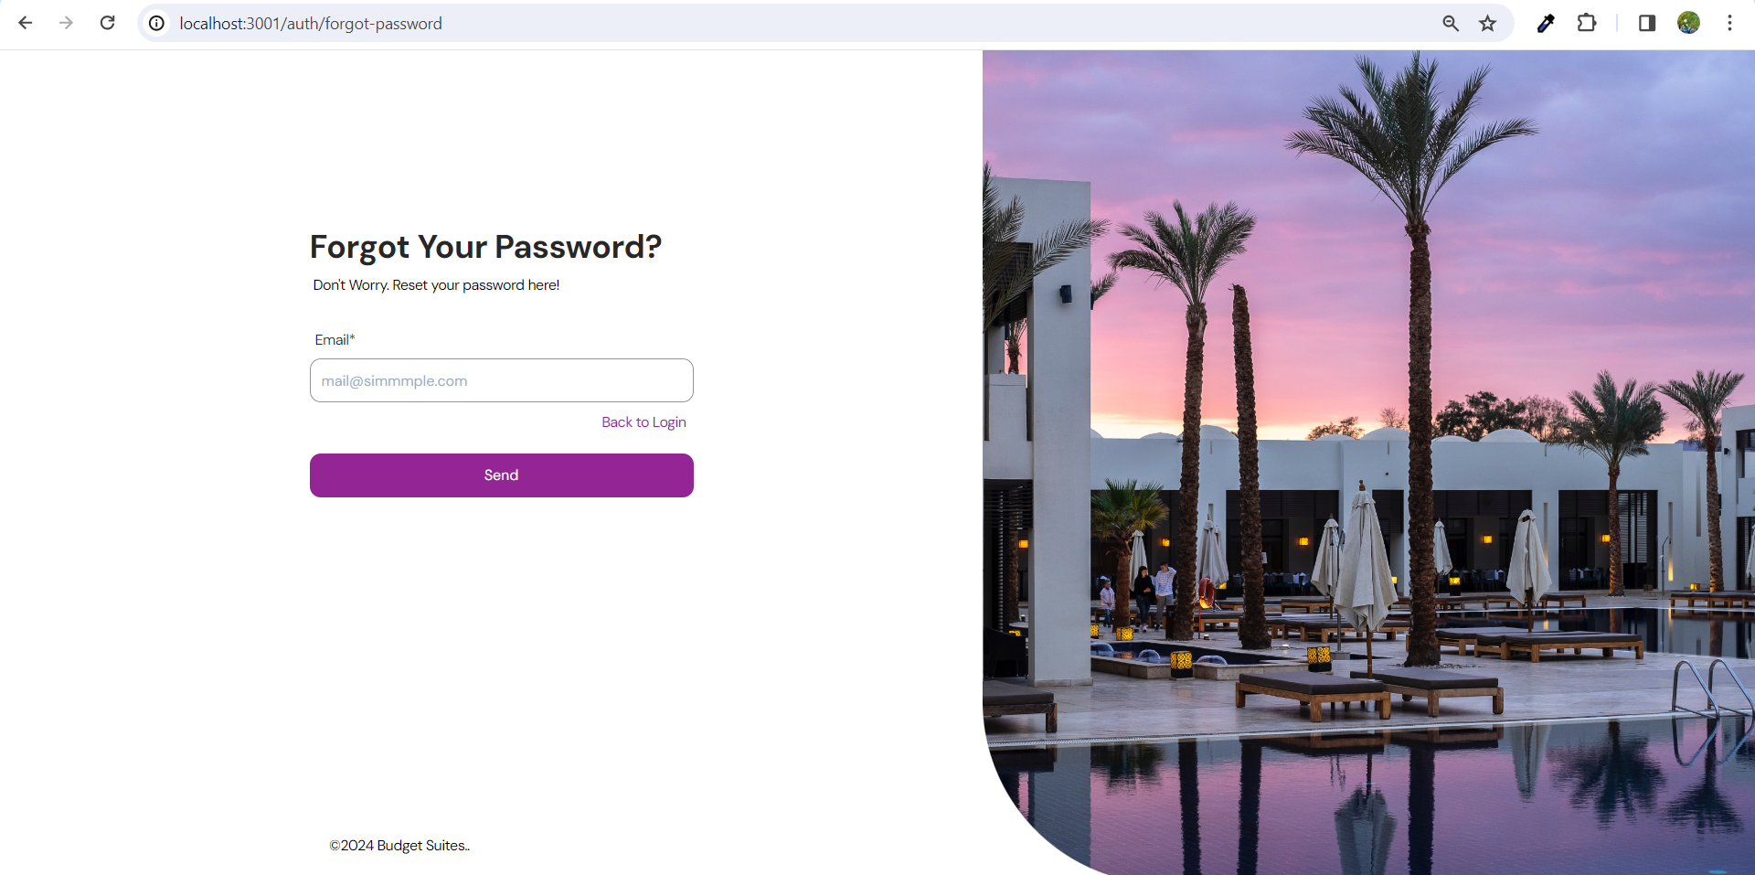
Forgot password

Slide 27
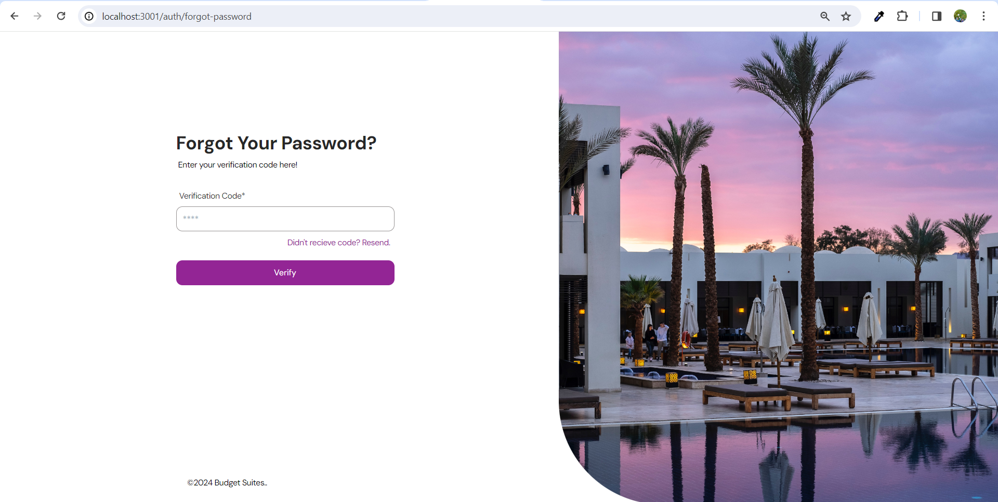
Verification code

Slide 28
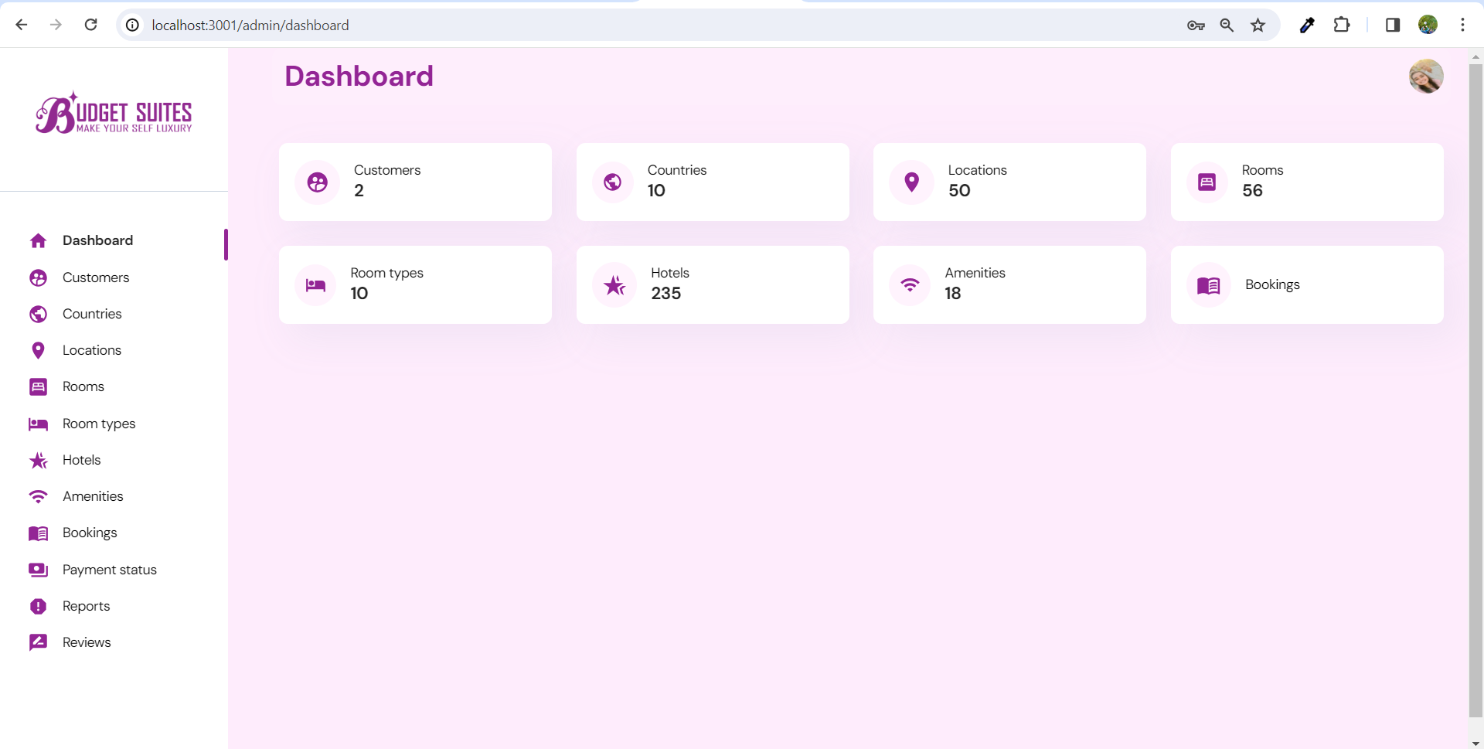
Dashboard

Slide 29
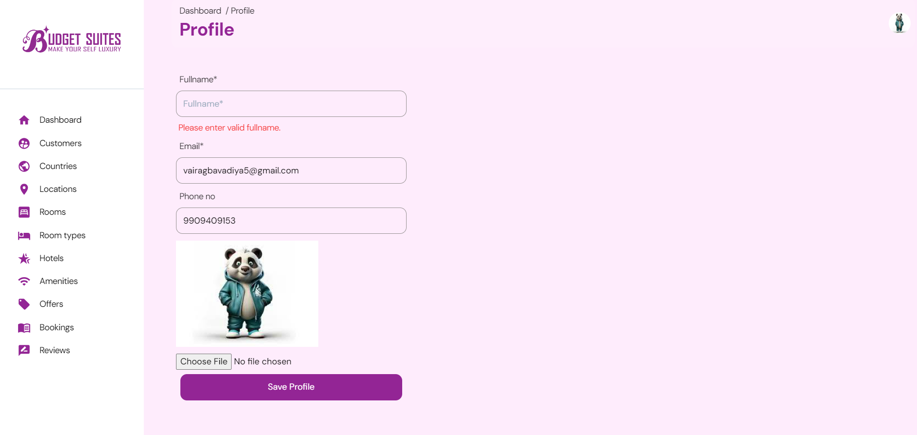
User profile validations

Slide 30
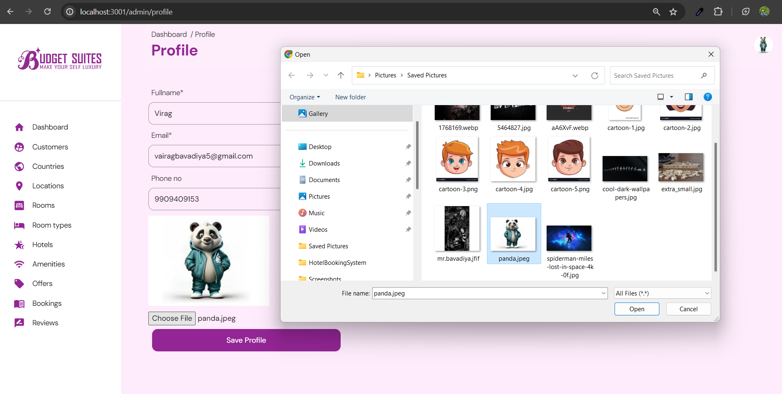
User profile photo update

Slide 31
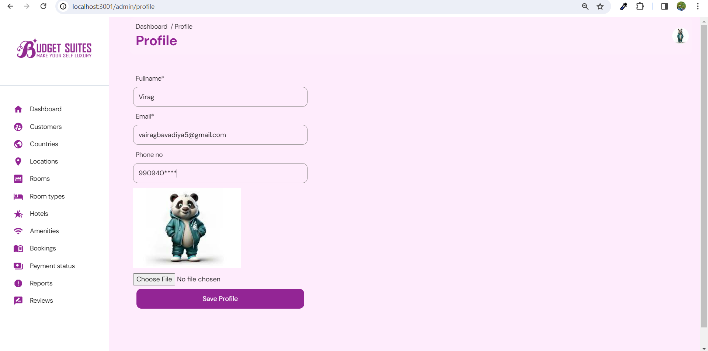
Profile

Slide 32
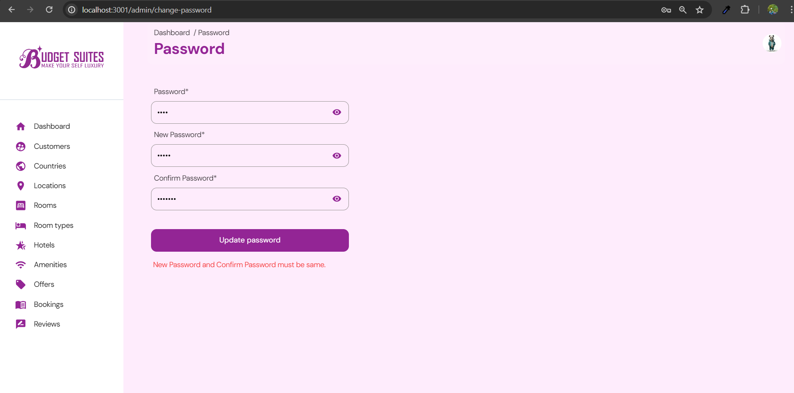
User pass validations

Slide 33
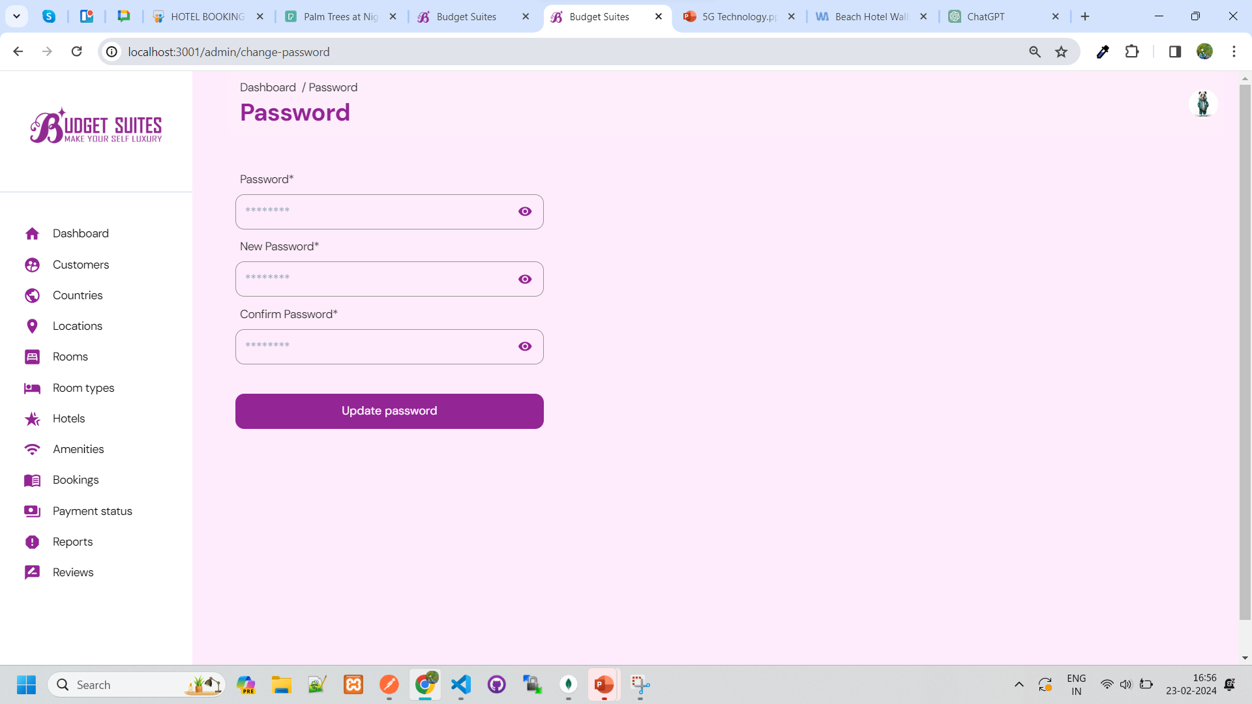
Change password

Slide 34
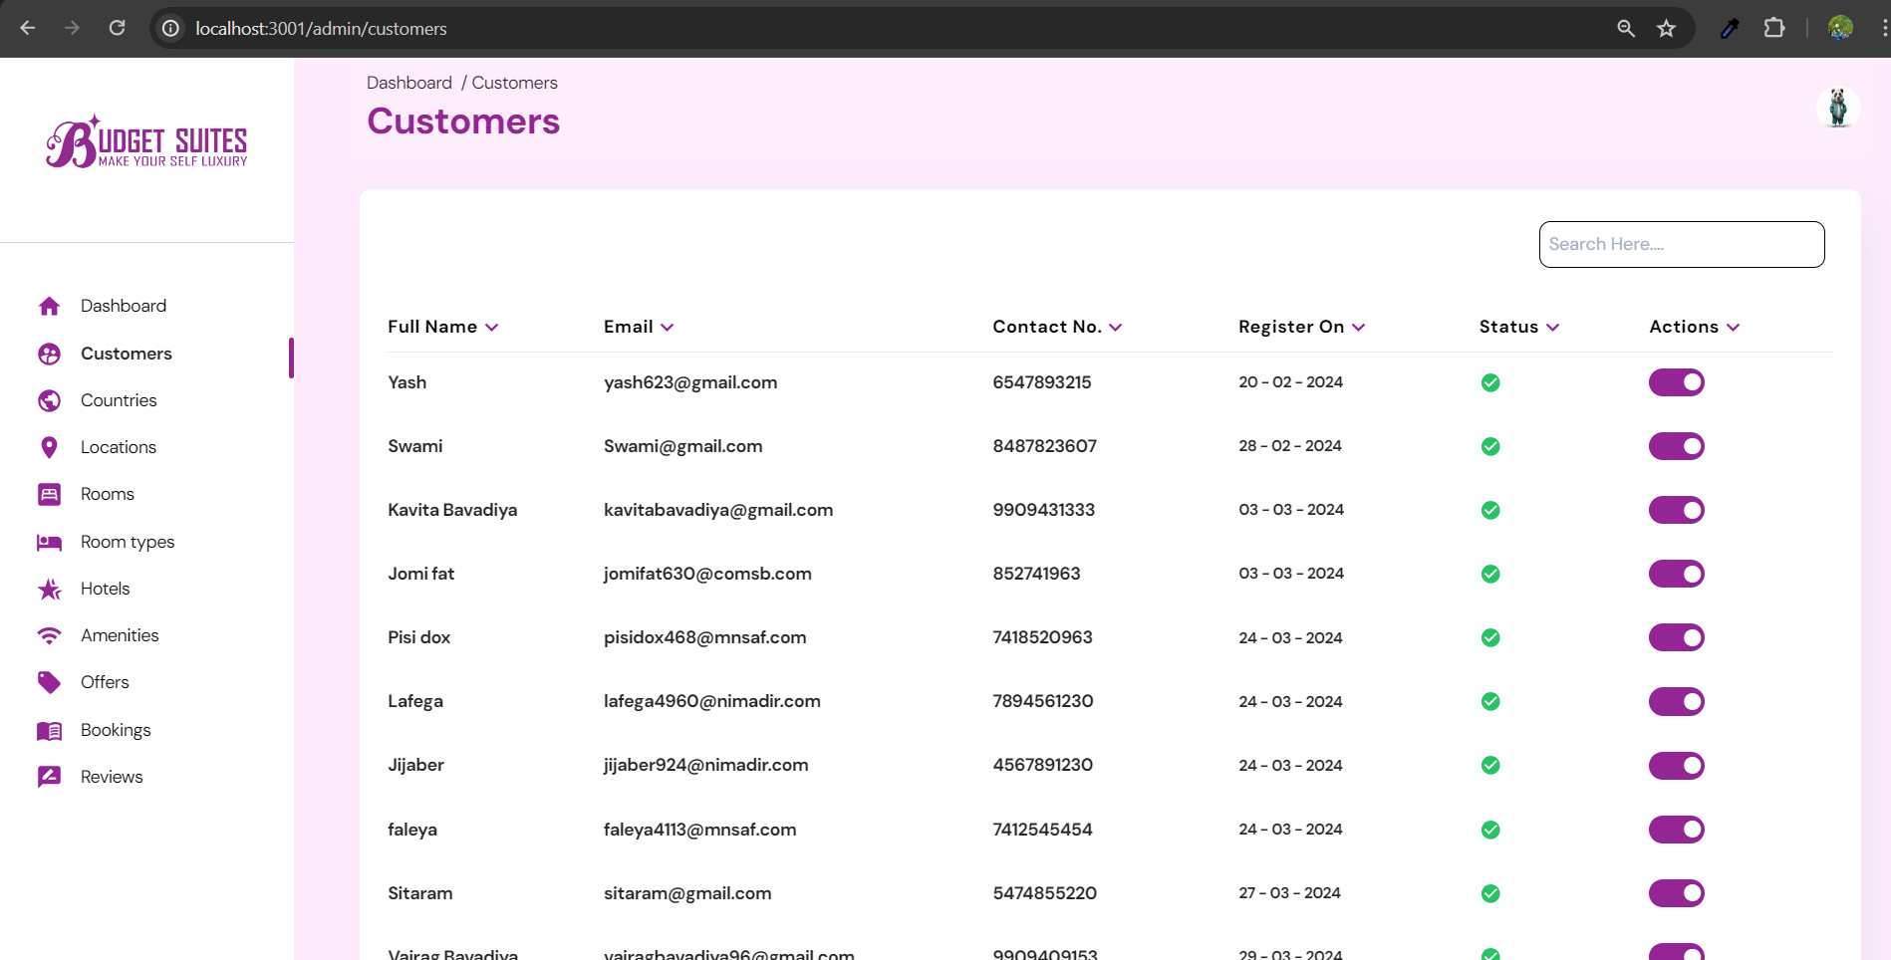
Customers

Slide 35
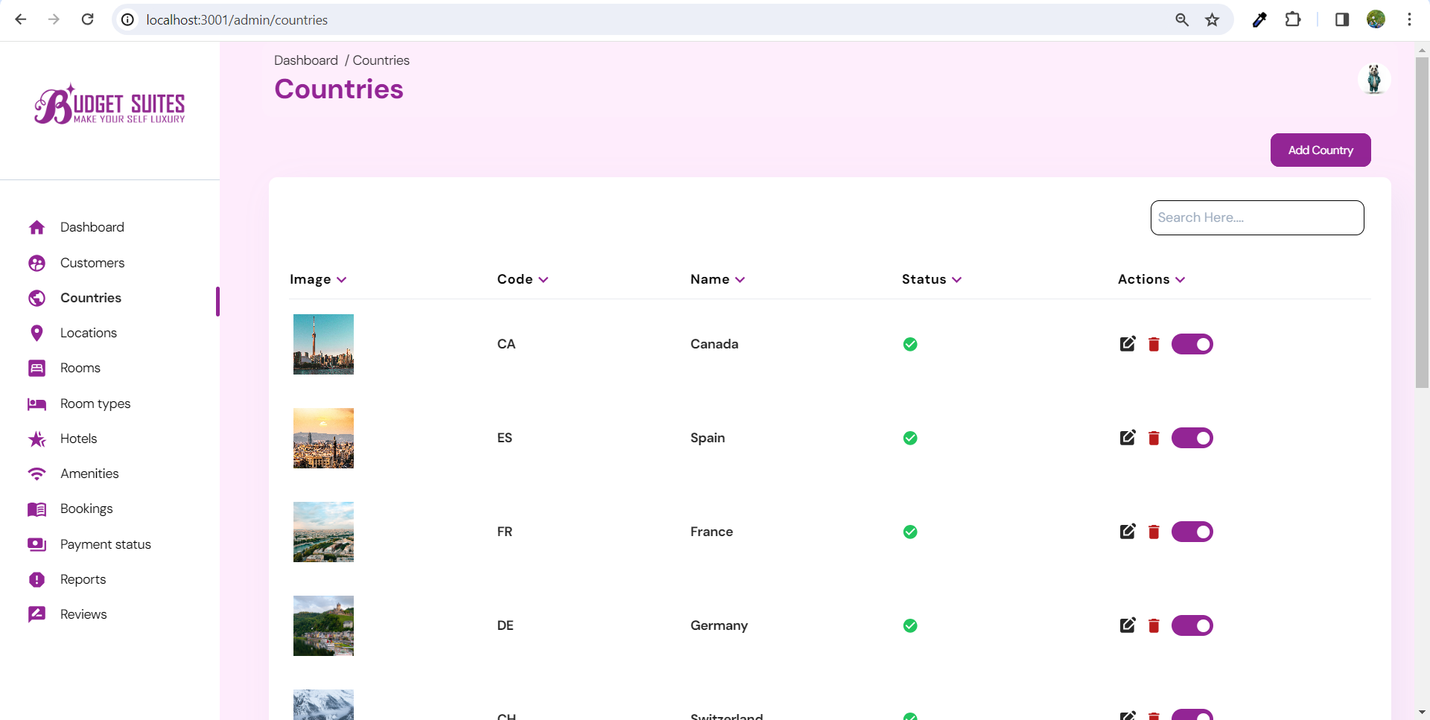
Countries LIST

Slide 36
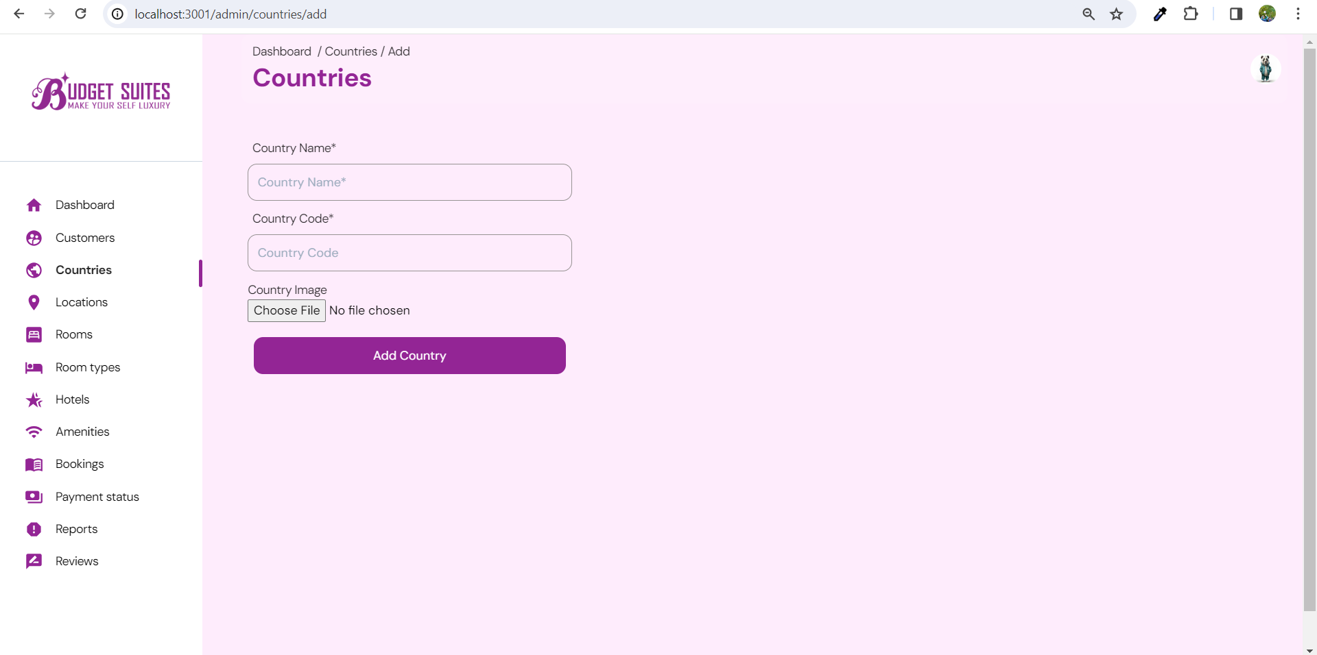
add CountrY

Slide 37
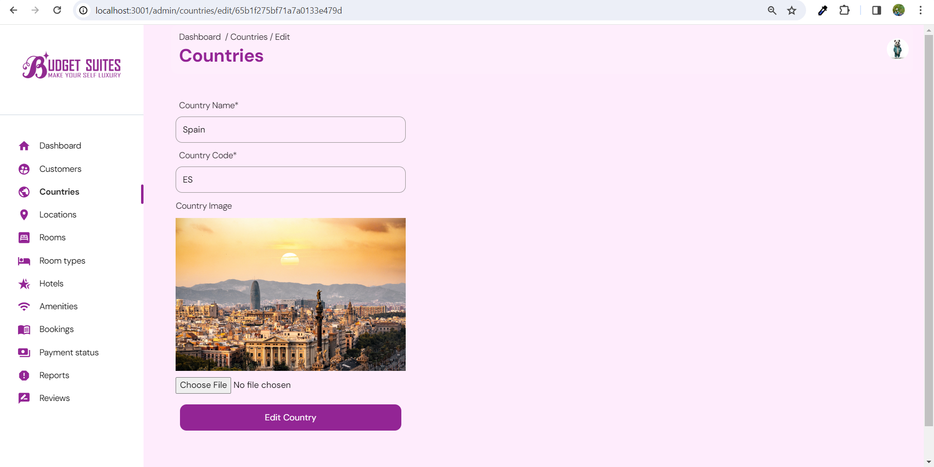
edit CountrY

Slide 38
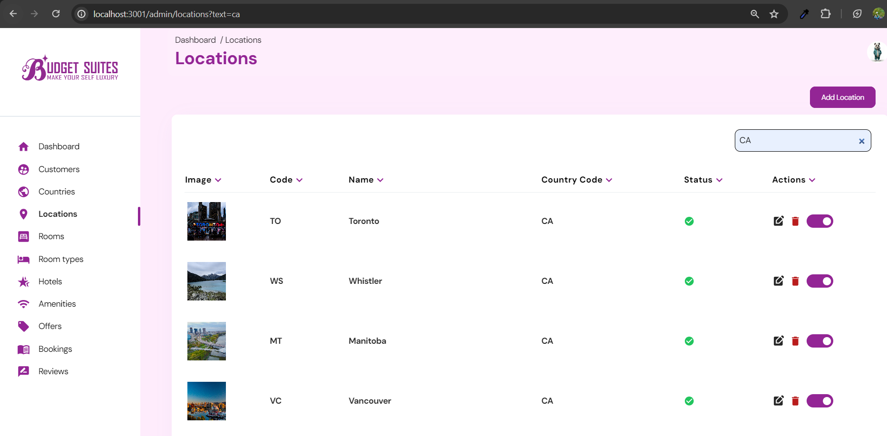
Search validation

Slide 39
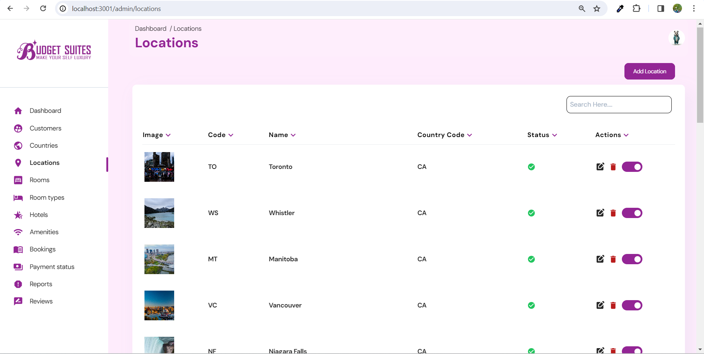
Locations LIST

Slide 40
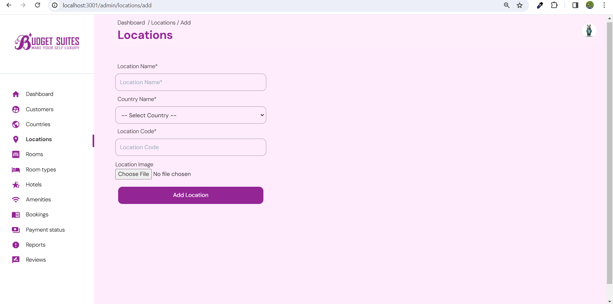
Add Location

Slide 41
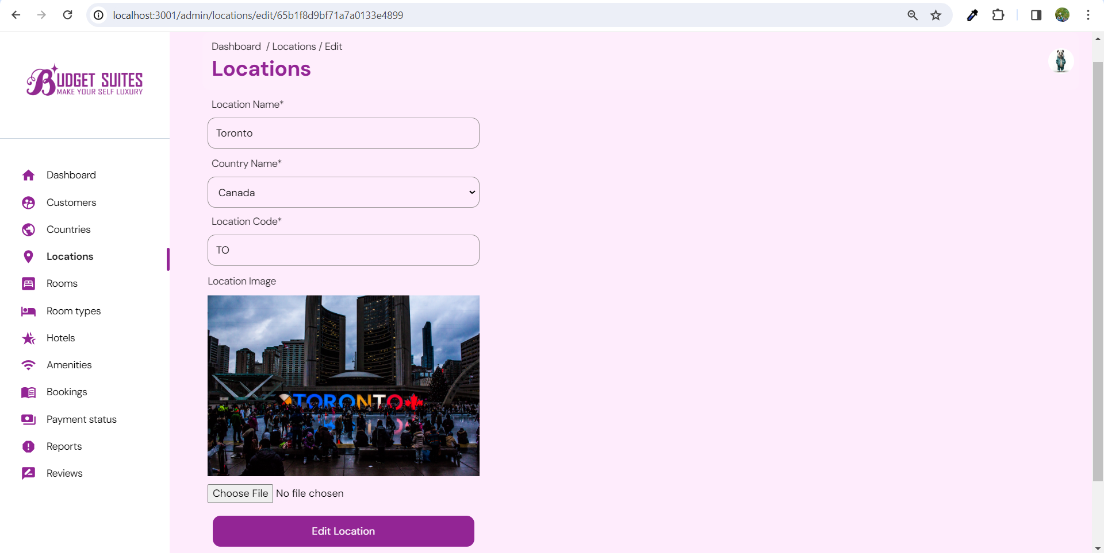
edit Location

Slide 42
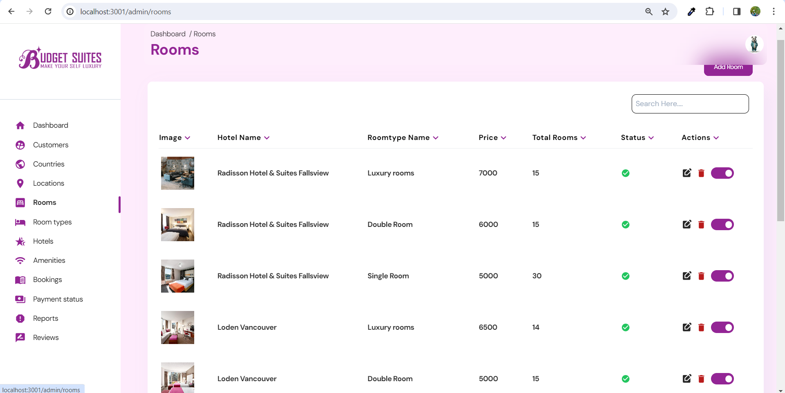
Rooms LIST

Slide 43
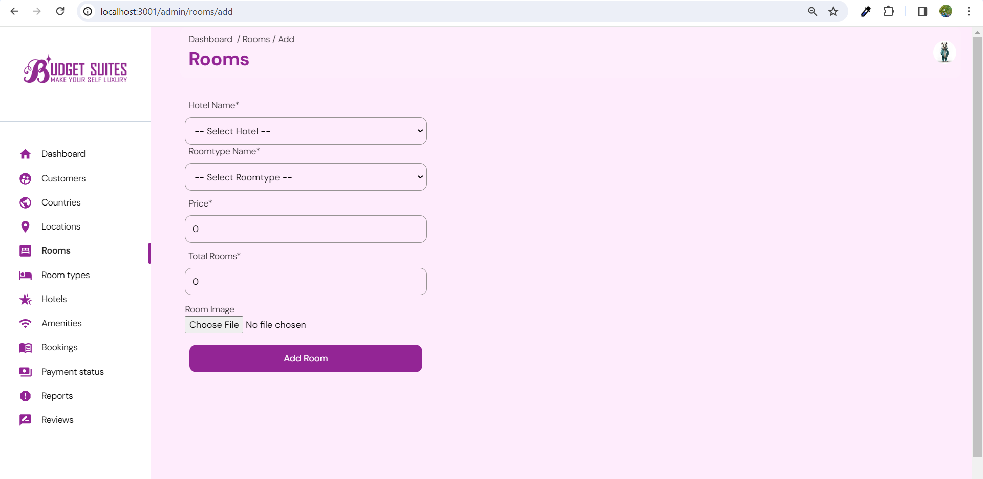
add Room

Slide 44
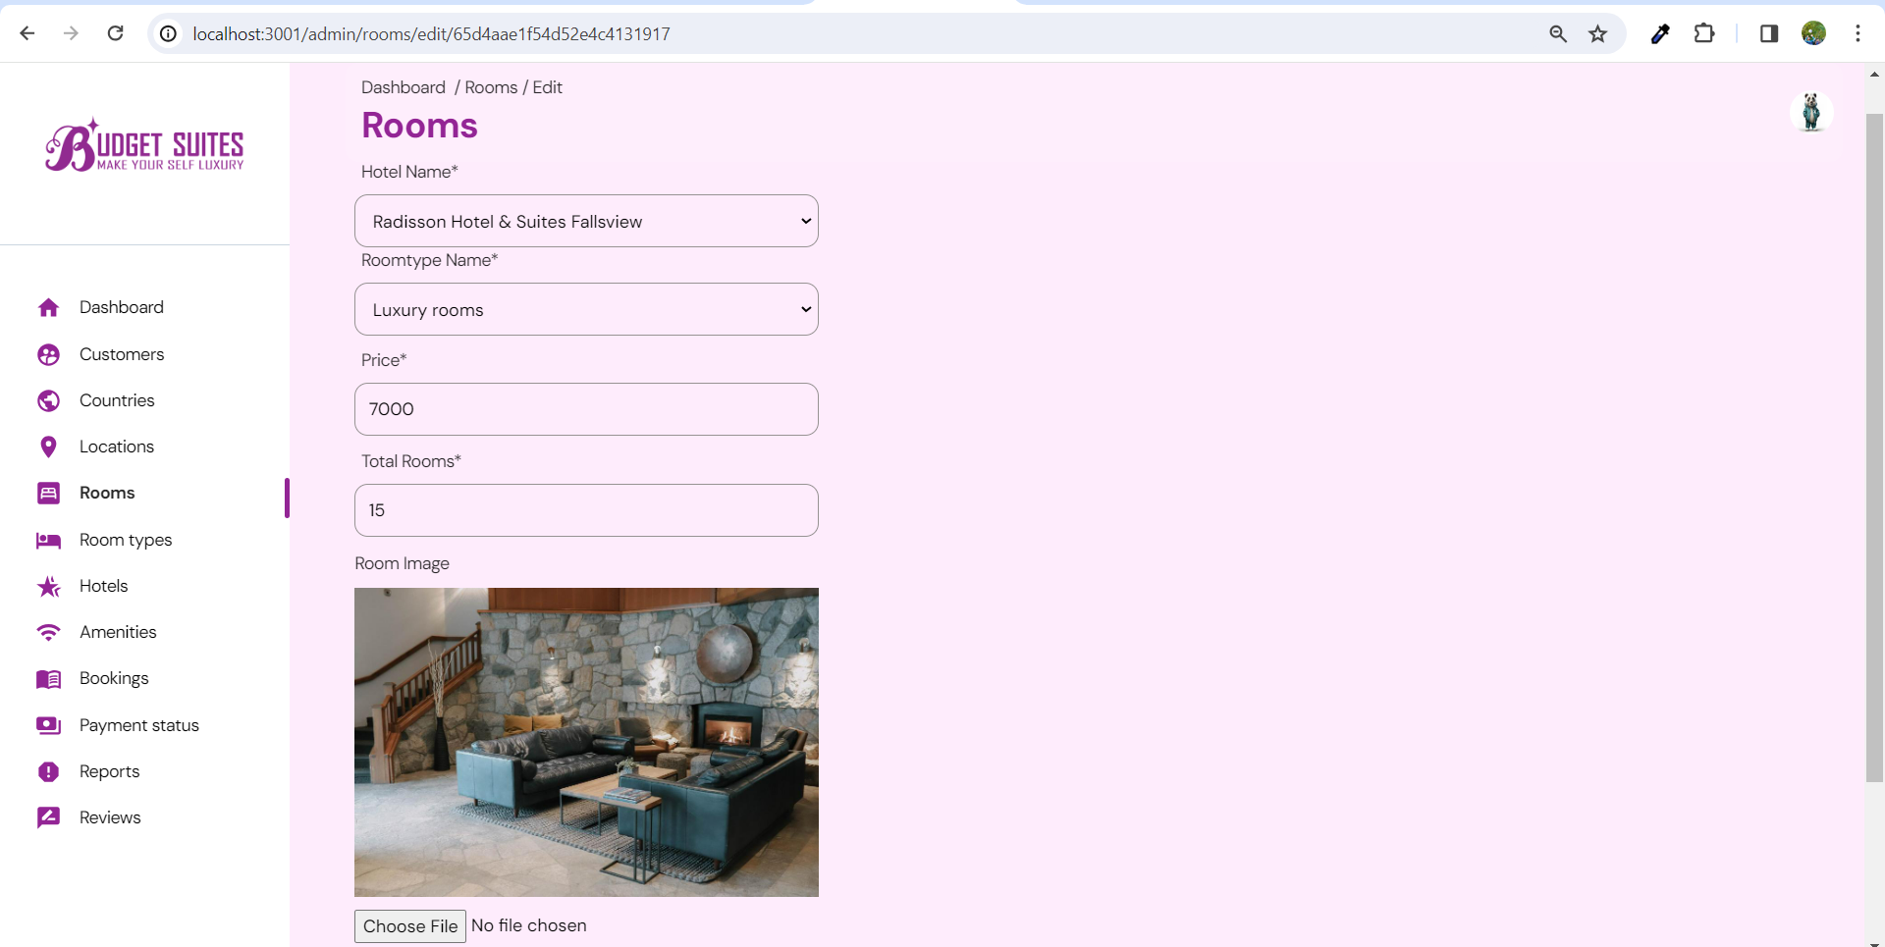
Edit Room

Slide 45
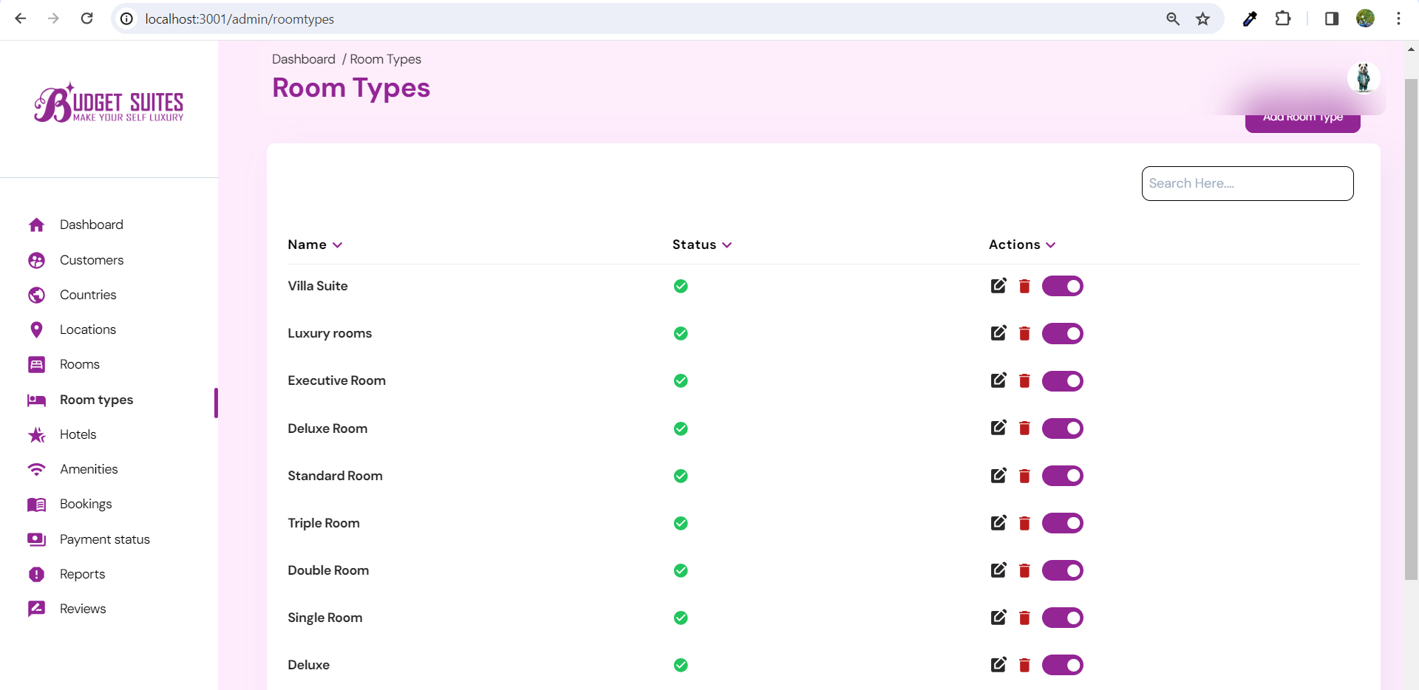
Room type LIST

Slide 46
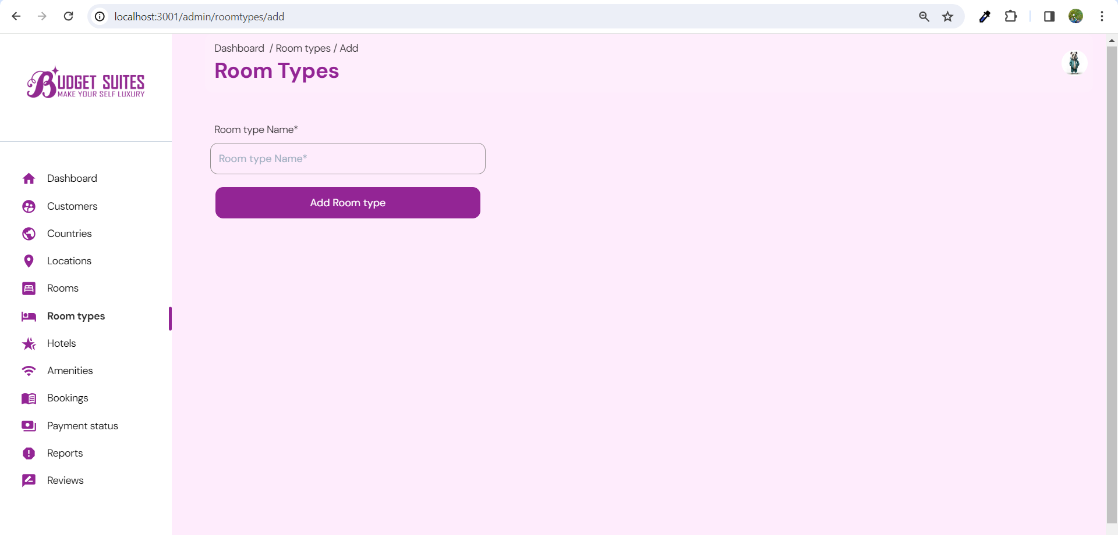
add Room type

Slide 47

edit Room type

Slide 48
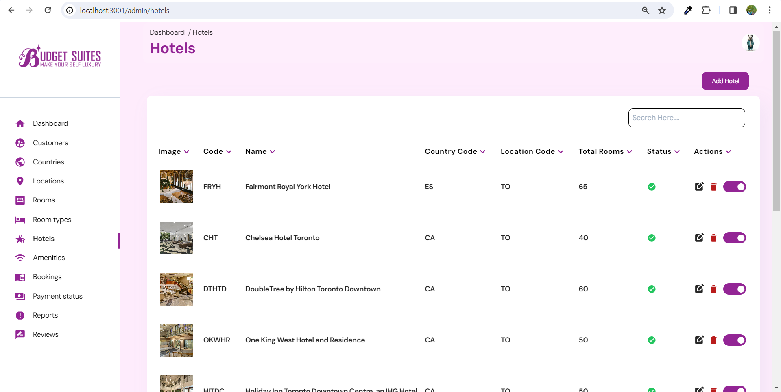
Hotels List

Slide 49
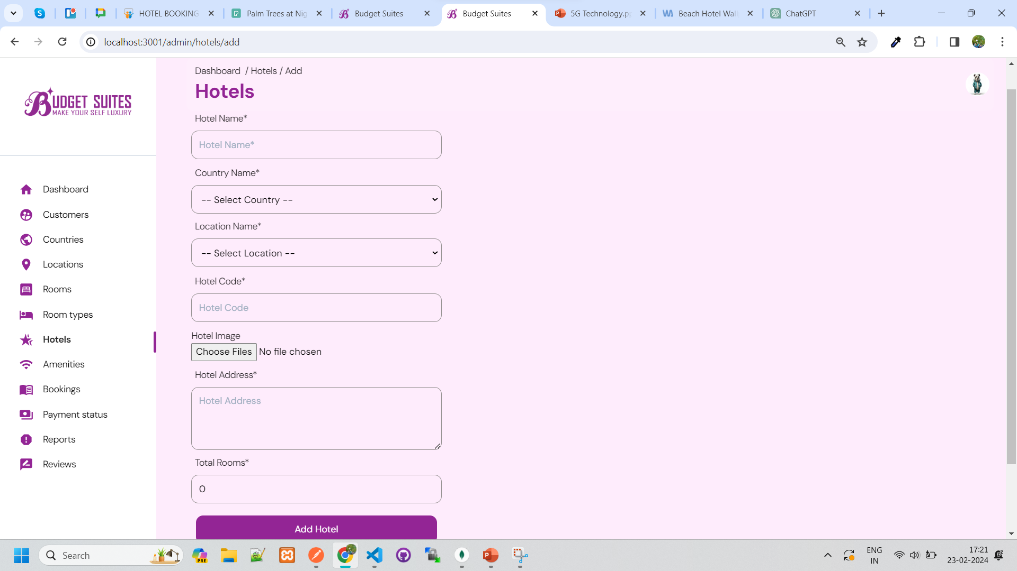
add Hotel

Slide 50
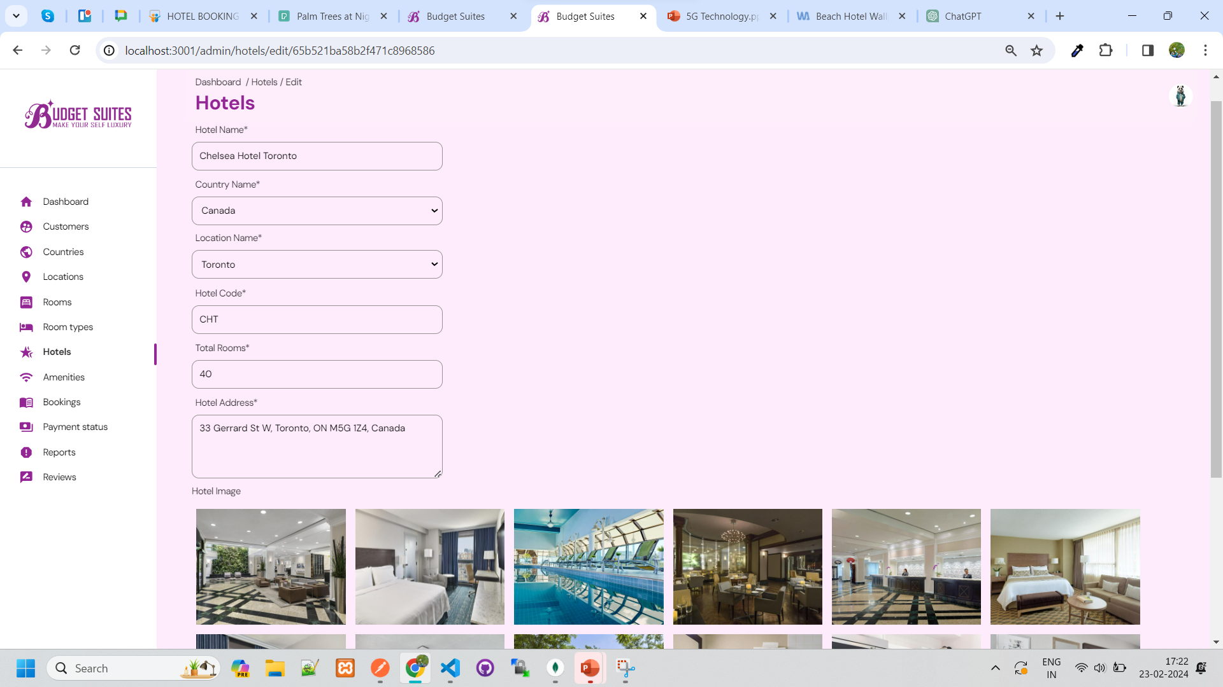
edit Hotel

Slide 51
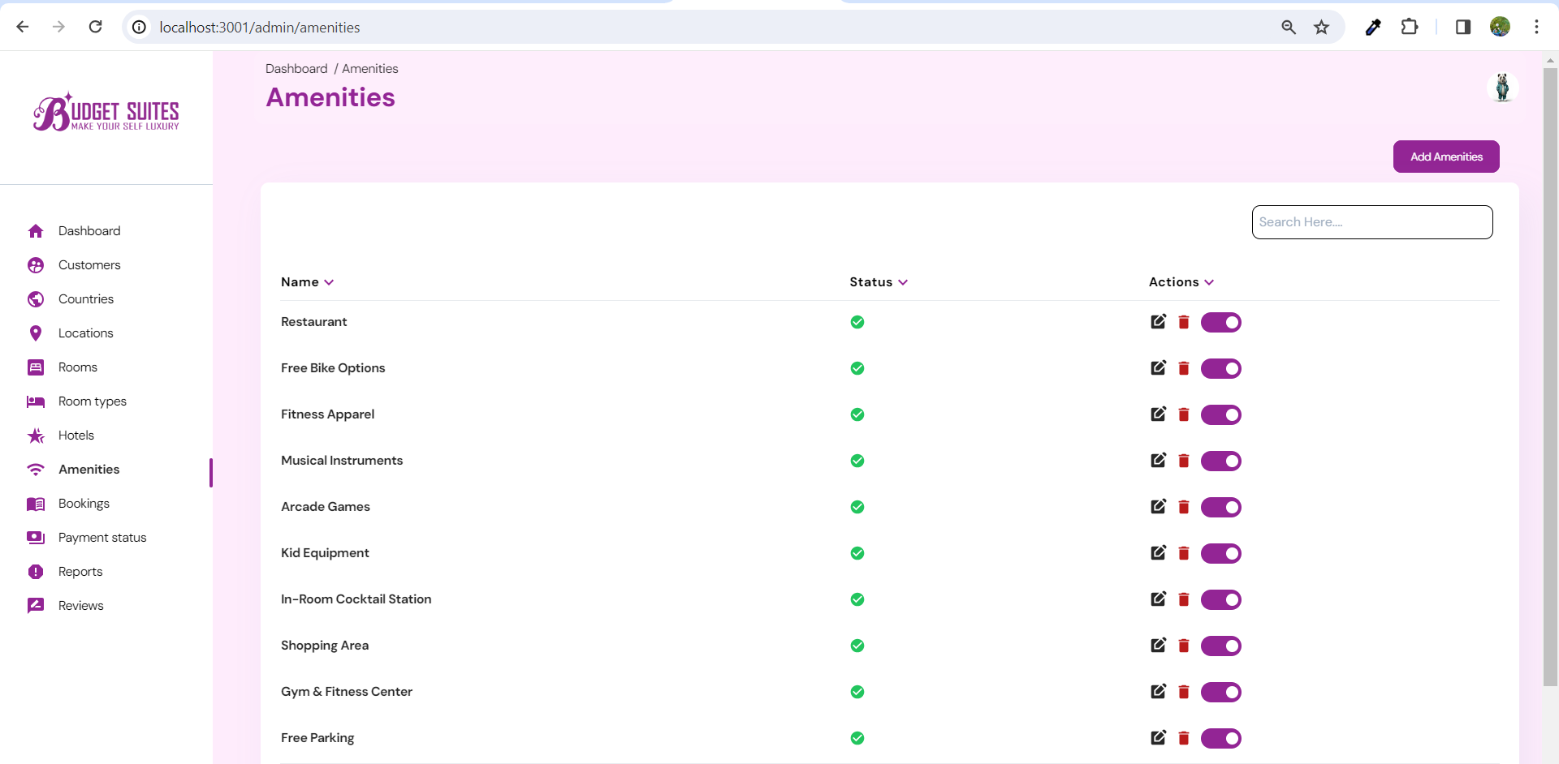
Amenities LIST

Slide 52
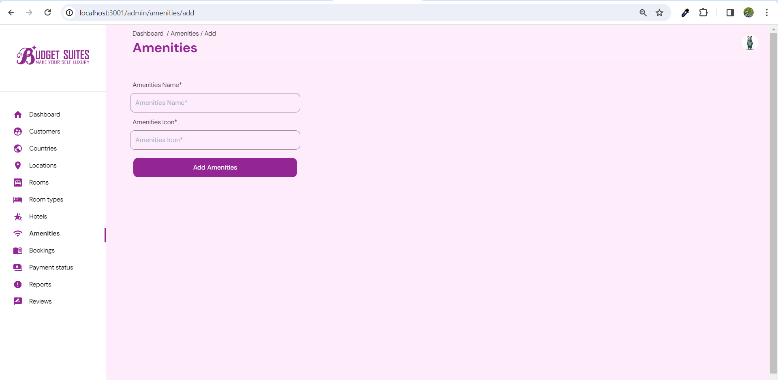
add Amenity

Slide 53
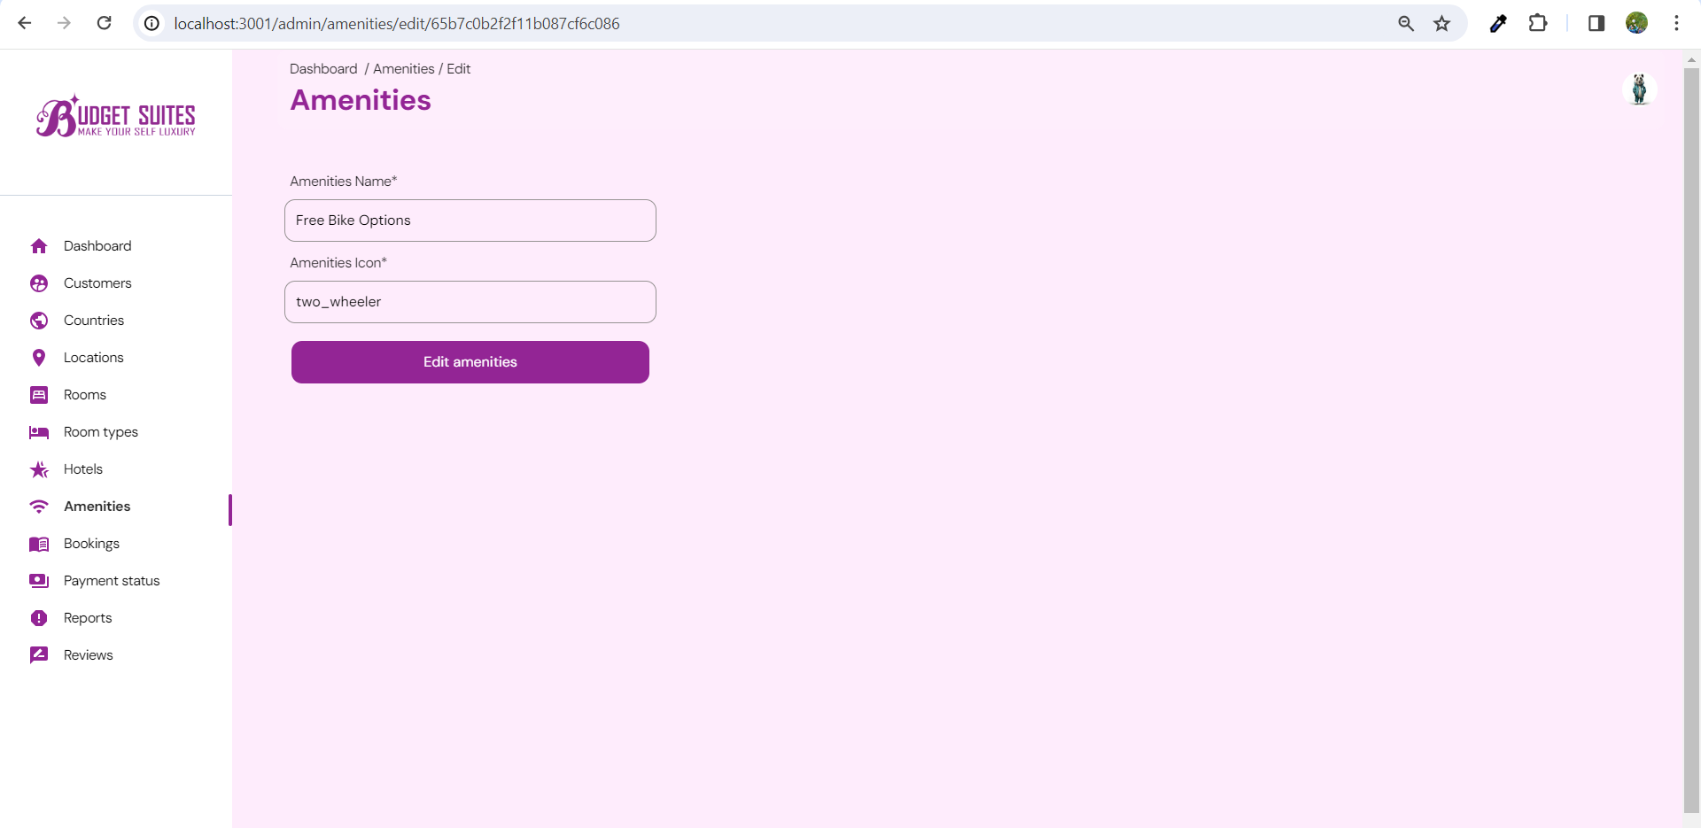
edit Amenity

Slide 54
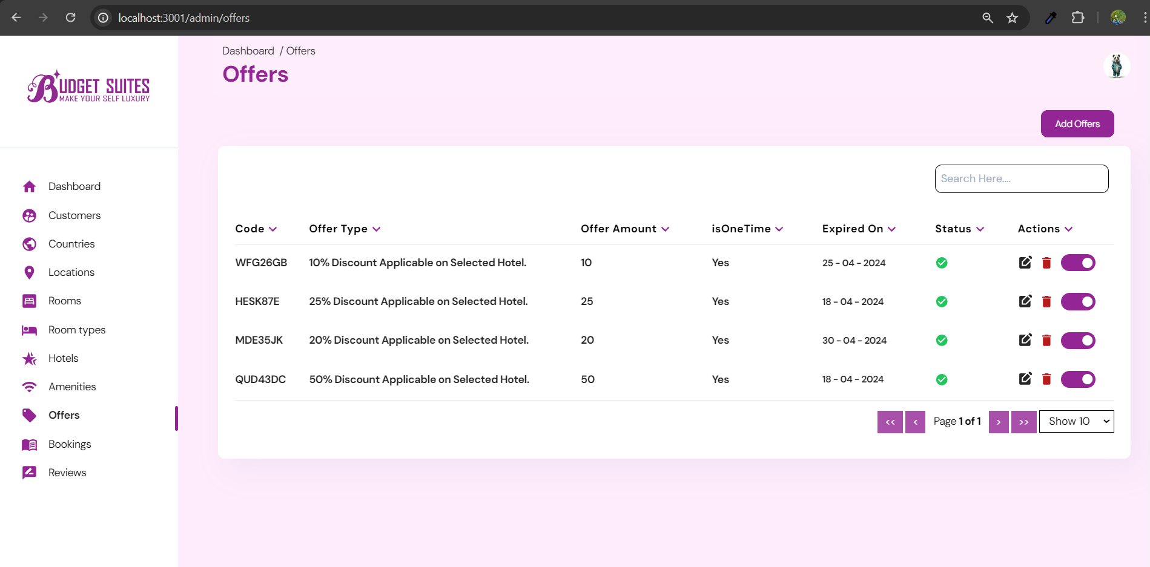
Offers list

Slide 55
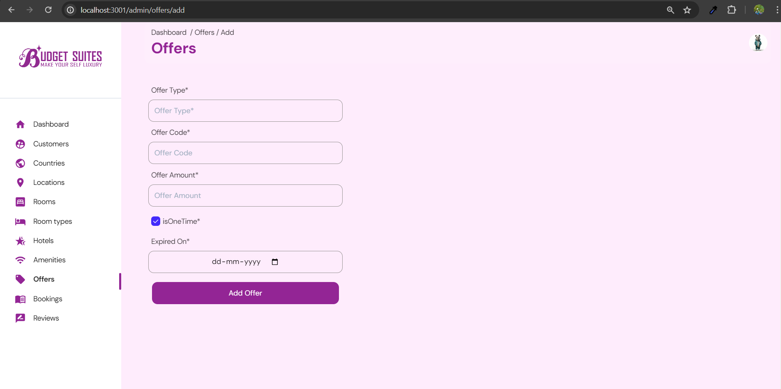
Add offer

Slide 56
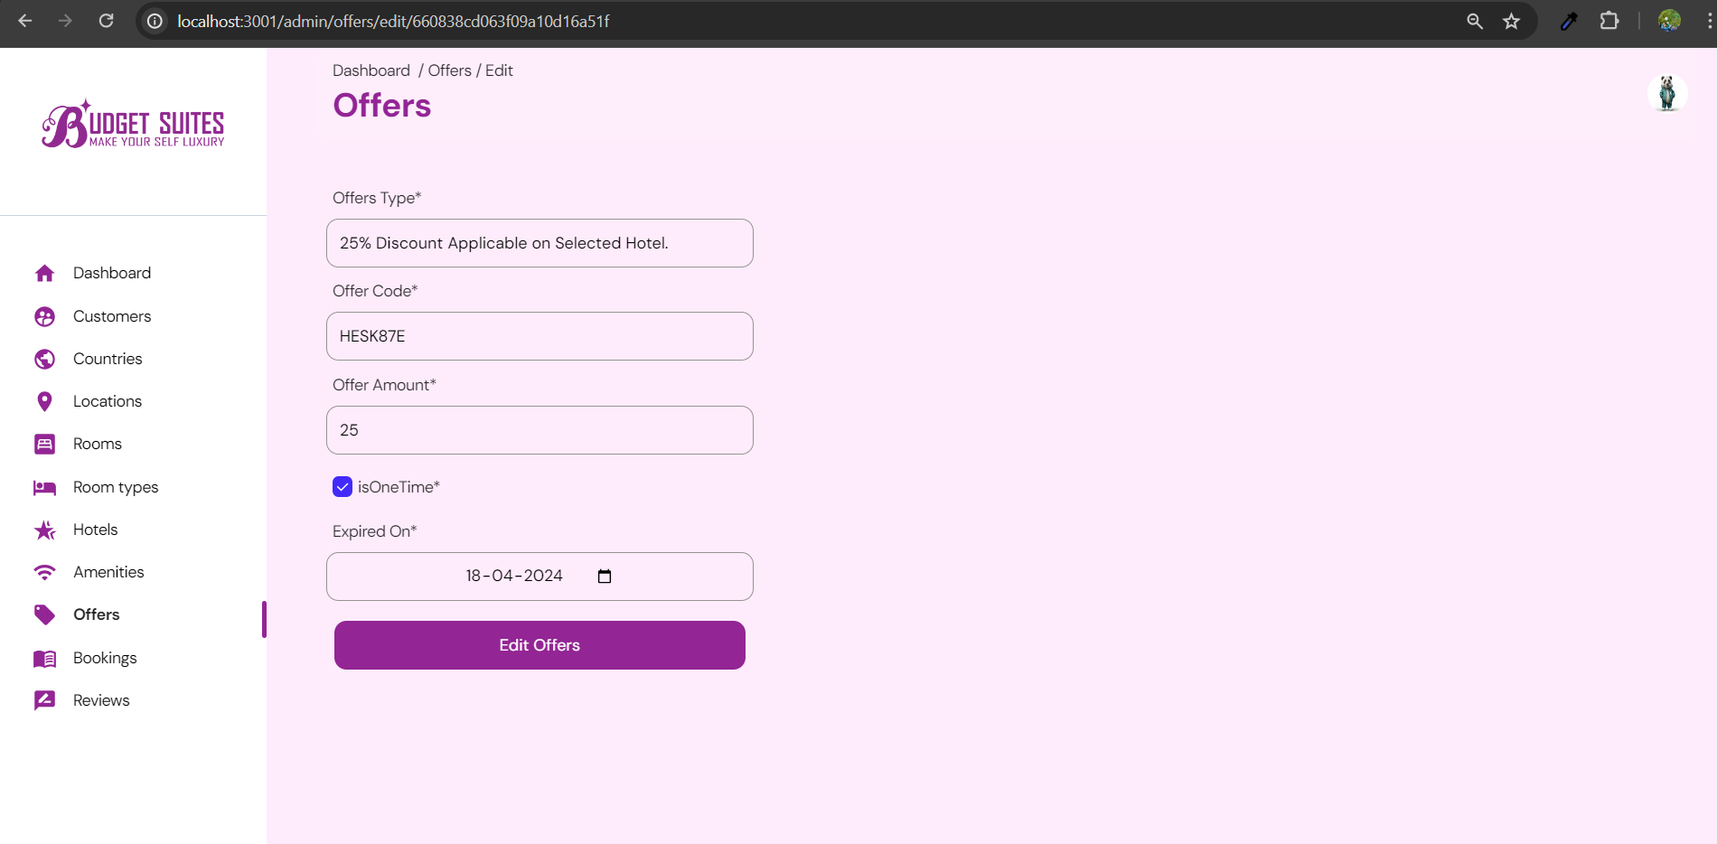
Edit offer

Slide 57
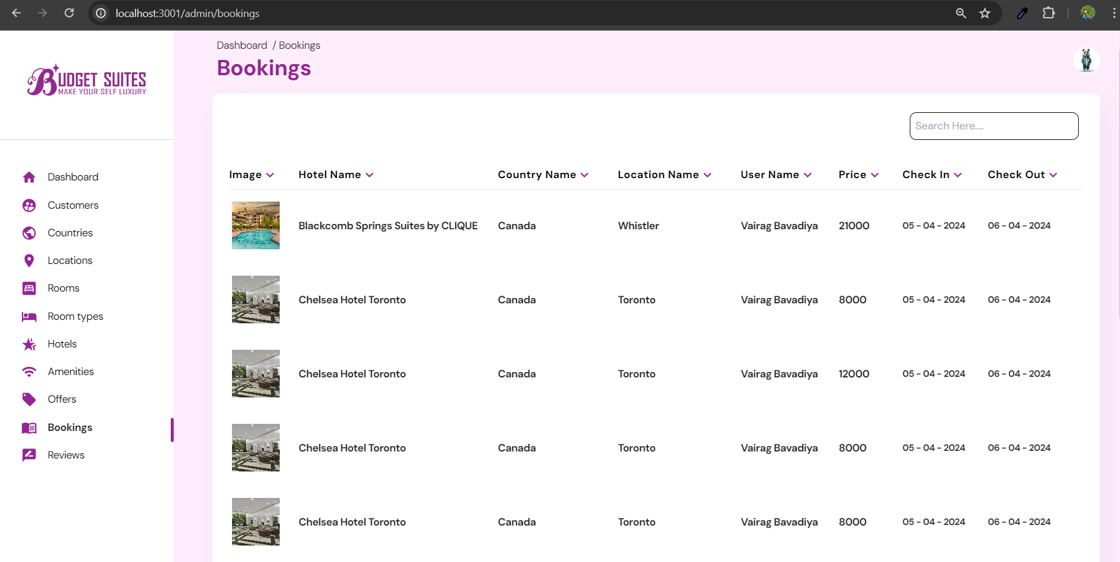
bookings

Slide 58
SnapShots
User Side

Slide 59
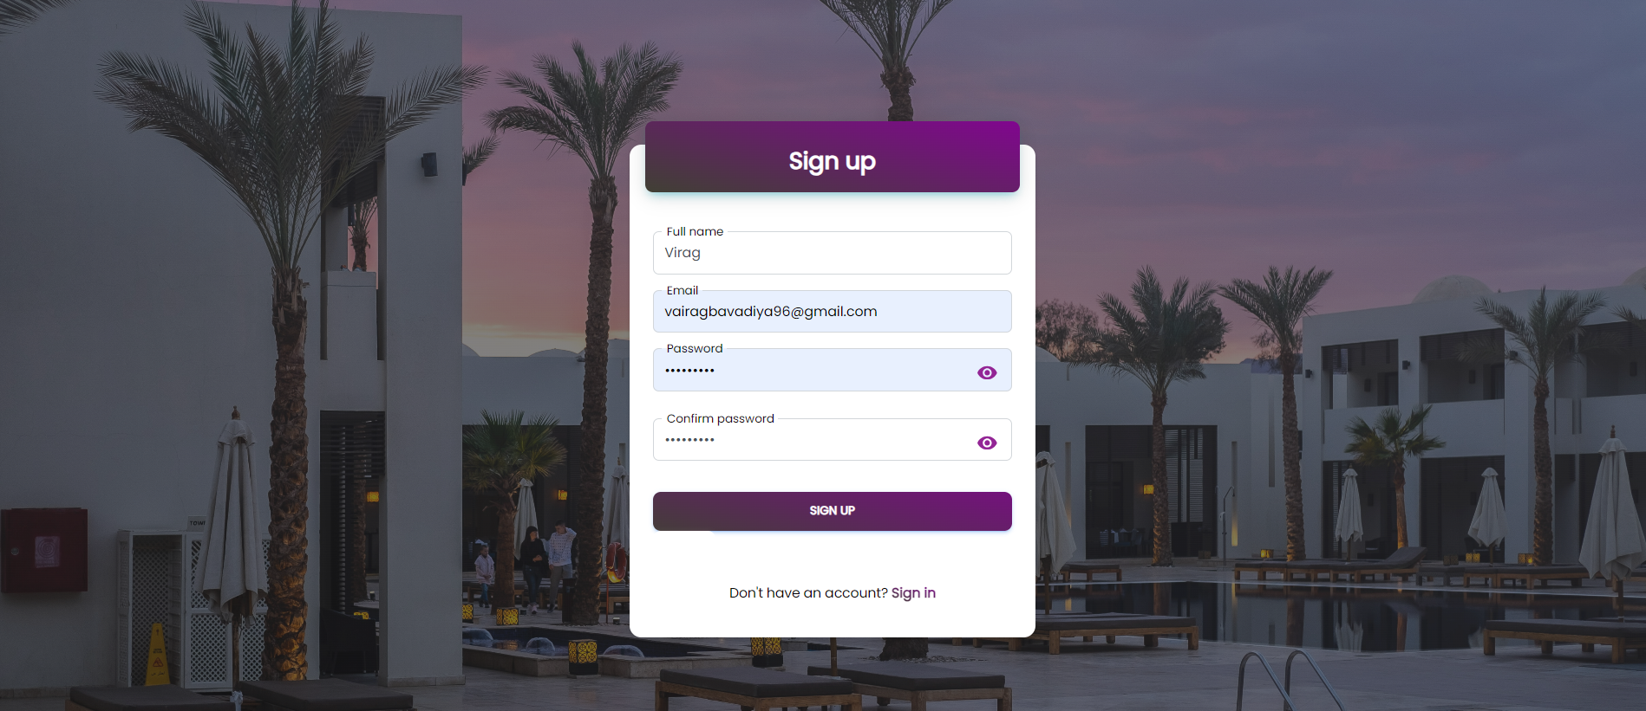
Sign-up page

Slide 60
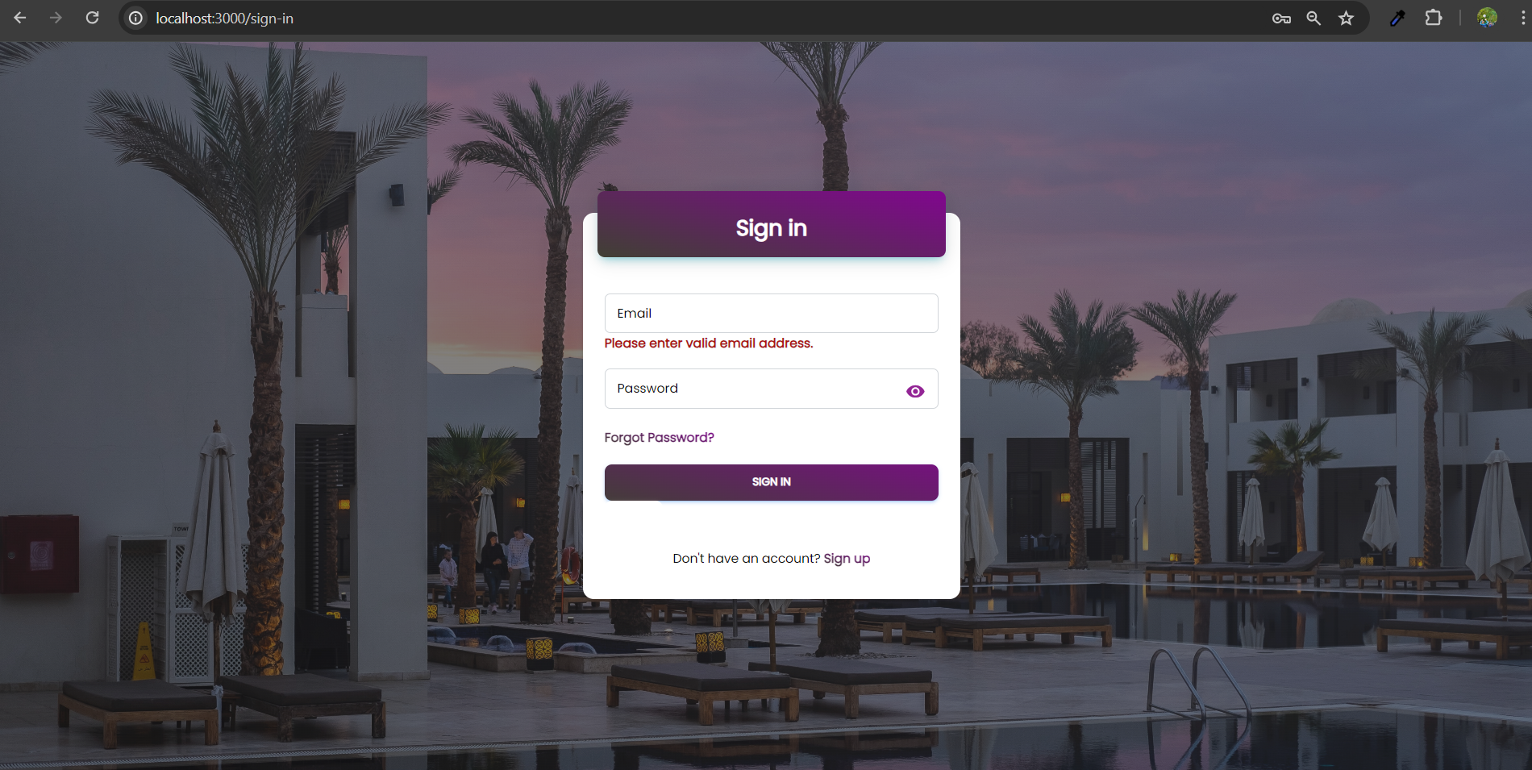
Sign-IN validation

Slide 61
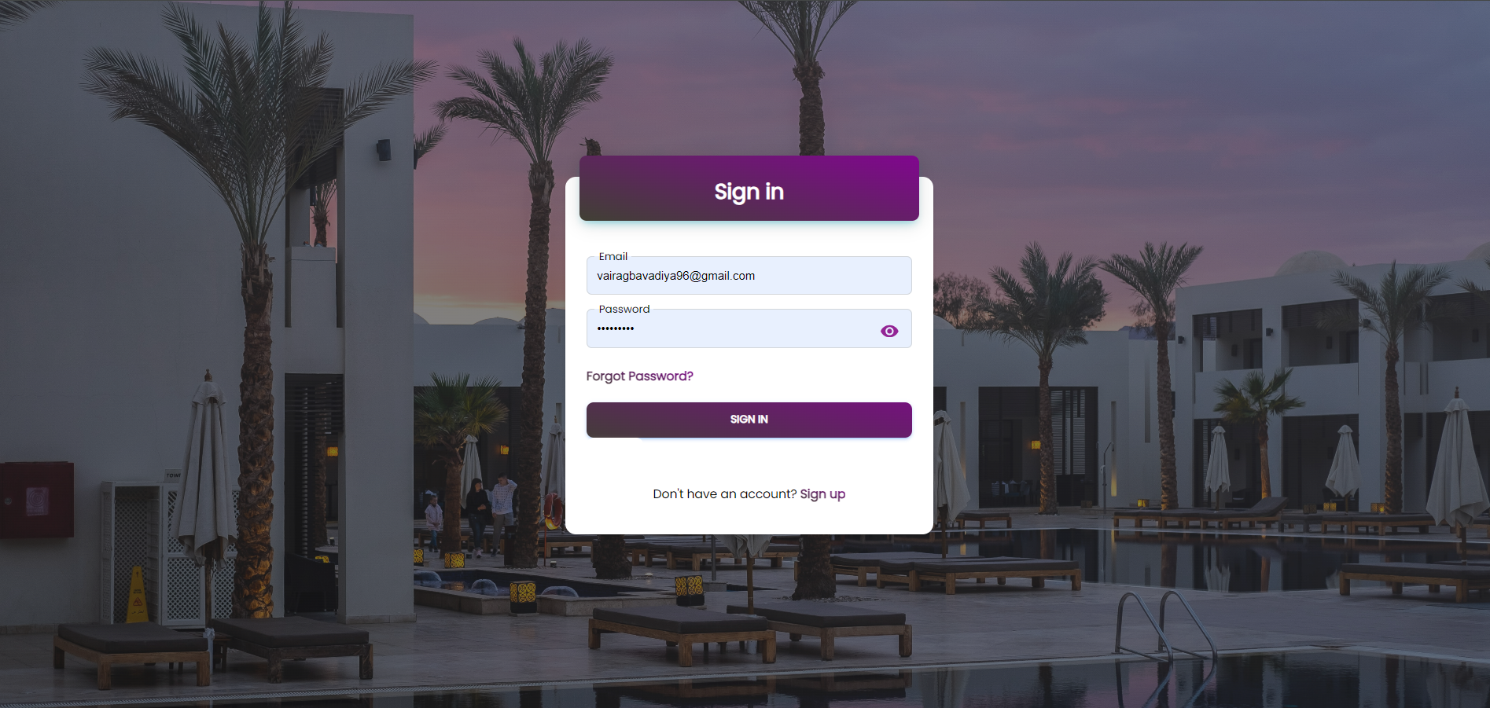
Sign-in page

Slide 62
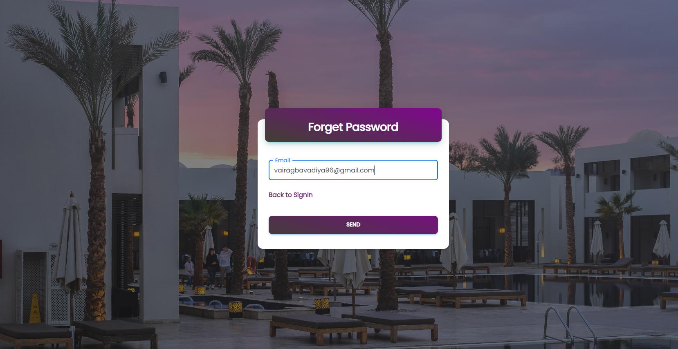
Forgot password

Slide 63
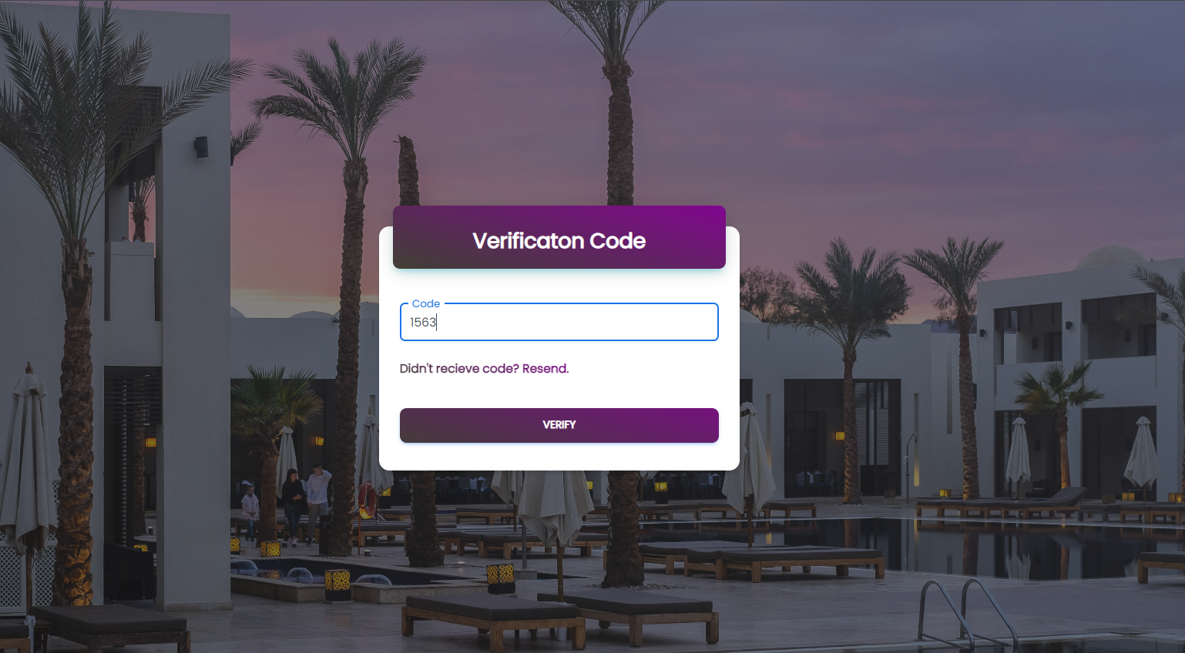
Verification code

Slide 64
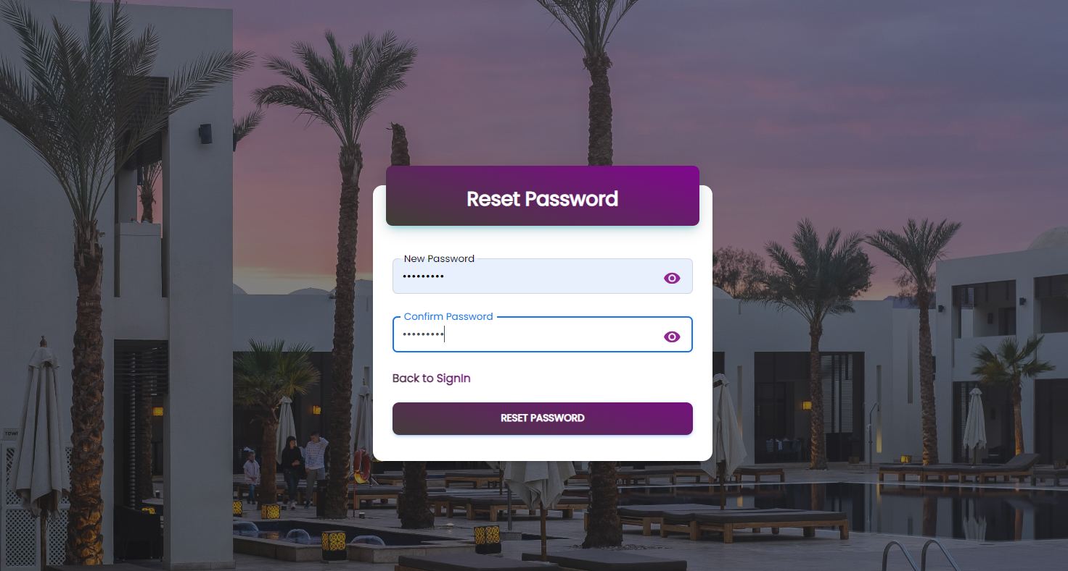
Reset password

Slide 65

Search hotel

Slide 66

Search hotel functionalities

Slide 67

Search hotel functionalities

Slide 68

Home page

Slide 69

Home page

Slide 70

Home page

Slide 71

About us

Slide 72

About us

Slide 73

Contact us

Slide 74

Hotels List

Slide 75

Hotel Details

Slide 76

Hotel Details Functionalities

Slide 77

Hotel Details Functionalities

Slide 78

Hotel booking

Slide 79

Hotel booking with discount

Slide 80

payment

Slide 81

User’s profile validation

Slide 82

User’s profile

Slide 83

User’s booking

Slide 84

Security

Slide 85

offers

Slide 86

Footer

Slide 87
THANK YOU

